Slide 1

Human Detection and counting
UNDER THE GUIDANCE OF
Prof. Prachi Dusa
PRESENTED BY –
Koushal Rudrawar - S19031431
Mandar Paygude - S19031
Pragati Pate - S19031
Vinayak Oza - S19031
ACADEMIC YEAR – 2021-2022

Slide 2
INTRODUCTION
The real-time detection of humans is emerging as a significant trend with data scientists and across widespread industries
Real-time human detection and counting is a vast, challenging and important field of research
In this project, we are going to build the Human Detection and Counting System with python through video/images .

Slide 3
PROBLEM STATEMENT
To build the Human Detection and Counting System . Detect the human present in the given image/video or live camera and give the total count of the people .

Slide 4
SCOPE
It has a wide scope due to it’s application’s in various domains.
To develop more accurate models with more efficiency.
Scope for development in adverse condition .

Slide 5
NEED
Analysis
Security purpose.
Surveillance.

Slide 6
MOTIVATION
To solve the issues to related to security , surveillance and analysis.
To build a system which could work in low intense light.
So we decided to make a REAL TIME HUMAN DETECTION System. We are interested in this project after we went through few papers in this area. As a result we are highly motivated to develop a system that recognizes objects in the real time environment

Slide 7
Literature SURVEY
Sr. | Title | Authors | Publications | Year | Description
1. | Human Detection using Histogram of oriented gradients and Human body ratio estimation | Kelvin Lee, Che Yon Choo, Hui Qing See, Zhuan Jiang Tan, Yunli Lee | IEEE Xplore | 2010 | In this paper, we present a human detection system using motion extraction and Histogram of Oriented Gradients features (HoG).
2. | Human detection in surveillance videos and its applications | Manoranjan Paul*, Shah M E Haque and Subrata Chakraborty | Springer | 2013 | The characteristics of the benchmark datasets are presented, and major applications of human detection in surveillance video are reviewed.

Slide 8
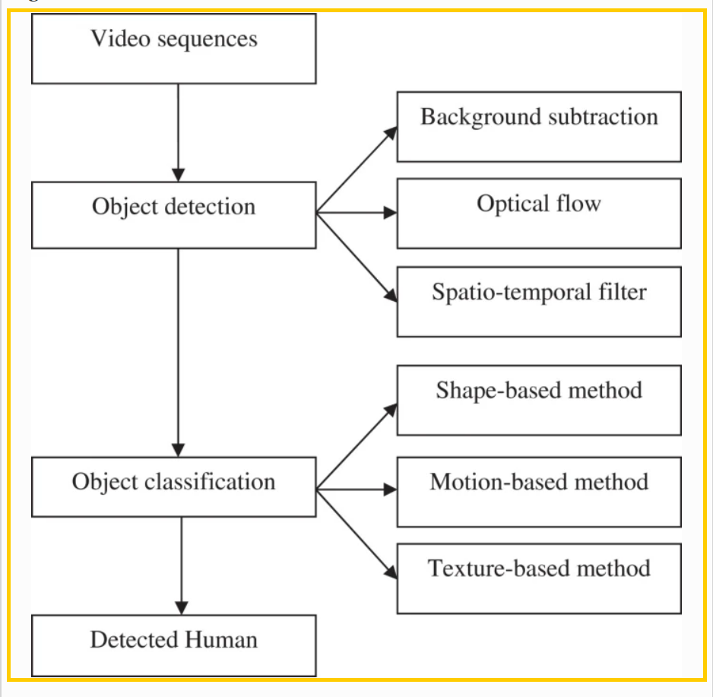
ARCHITECTURE DIAGRAM

Slide 9
ALGORITHMIC APPROACH
Histogram of Oriented Gradient Descriptor.
HOG is a feature descriptor used in computer vision and image processing for the purpose of object detection. This is one of the most popular techniques for object detection, to our fortune, OpenCV has already been implemented in an efficient way to combine the HOG Descriptor algorithm with Support Vector Machine or SVM.

Slide 10
RESULT
Developed the project where you can supply the input as: video, image, or even live camera and you will give get the human count.

Slide 11
CONCLUSION
We have learned how to create a people counter using HOG and OpenCV to generate an efficient people counter.
Detecting human beings accurately is one of the major topics of vision research due to its wide range of applications.
Major applications of human detection in surveillance video are reviewed.

Slide 12
REFERENCES
1. https://ieeexplore.ieee.org/Xplore/home.jsp
2. https://docs.opencv.org/
3. [Dalal2005] Navneet Dalal and Bill Triggs. Histogram of
oriented gradients for human detection. 2005.
4. https://viso.ai/deep-learning/object-detection/

Slide 13
THANKYOU !!!

